Slide 1

Weekly Review
20/04/21
Tasks
Rewards were not representing transitions very well – Updated rewards✅
Displaying network output plots ✅
Ran custom SAC with environment cloth_corner.py (from original repo) ✅
Understand why the value and entropy become empty⚠️In progress
Problems
Value output and entropy become empty after just a couple of iterations
To-Do Items for Next Week
Understand why the value and entropy become empty
Compare custom SAC implementation with rlpyt implementation
To-Do Later

Slide 2
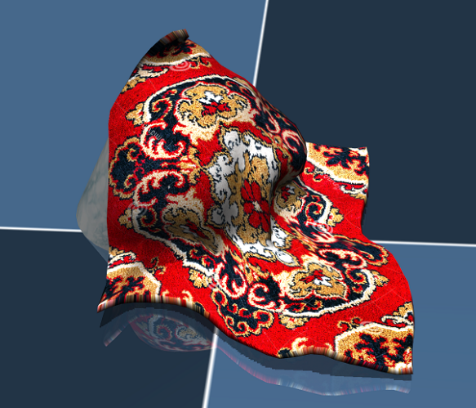
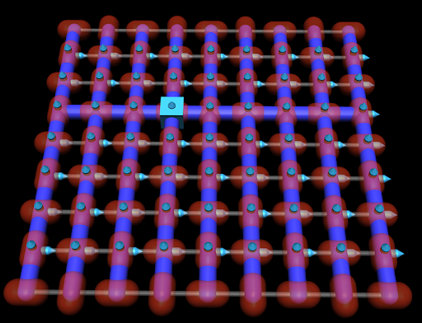
RL Problem for obtaining one flat seam
13/04/21
Goal
Obtain one flat seam
Given
Cloth in mujoco represented by 64 particles in 8*8 grid
Observations
[x,y,z] positions of 4 points adjacent to corner 1
Actions
Random [x,y] movement of corner 1
Corner 1

Slide 3
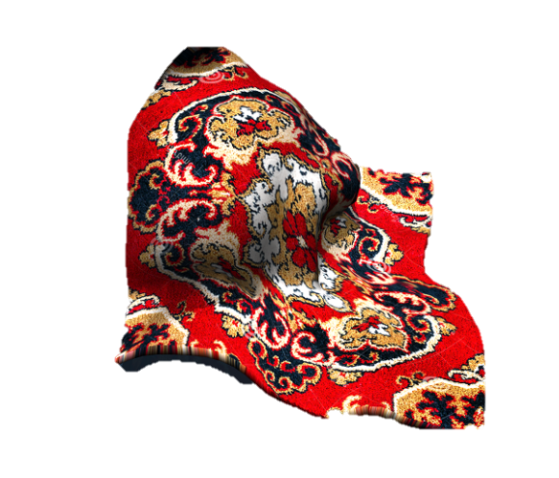
RL Problem for obtaining one flat seam
13/04/21
Goal
Obtain one flat seam -> Corner particle + 3 adjacent particles in a straight line
Reward
Join 1st point and last point
Project on x,y plane
3. Reward is proportional to :
(1 -1 * (x,y,z) distance from the ideal line)*10
Step 1
Step 2
Updated reward
X
X
X
X
0.3
0.3
0.3
Step 3
z = 0
Updated reward definition such that it gives a reward of > 9 for flat position but very low values for other positions -> added weight factors for x,y,z components (more weight for z divergence)

Slide 4
THANK YOU

